Slide 1
Endocrine Control Systems

Slide 2
Why should a dentist (or a doctoral student) care about endocrinology
Clinical manifestations of endocrine pathophysiology
Diabetes (Insulin Insufficiency/Resistance)
Periodontitis
Mucusal disease
Altered taste
Parotid gland enlargent
Potential hypo/hyperglycemia
Hypoparathyroidism (Not Enough PTH)
Low calcium density, hypoplasia of enamel and dentin
Candidiasis
Delayed eruption, shortened roots
Hyperthyroidism (T3/T4 Overproduction)
Malocclusion
Demineralization
Anxiety/restlessness
Acromegaly (GH Overproduction)
Accelerated tooth eruption
Enlarged jaw, abberant tooth spacing
Cushing’s (Cortisol Overproduction)
Periodontis, swelling of gums
Easy bruising
Addison’s Disease (Cortisol Insufficiency)
Blotchy melanin patches in oral mucosa

Slide 3
Things you (should) already know
Regulation of renal function (Tigyi)
Renin/Angiotensin/Aldosterone/ANF/Vasopressin
Regulation of GI function (Johnson)
Gastrin/CCK/GIP/Secretin/VIP/Motilin
Blood Pressure Regulation (O’Connell)
Angiotensin/Vasporessin/Adrenaline/Noradrenaline/Dopamine/Endothelin
Cardiac Function (Mancarella)
ANP/Adrenaline/Noradrenaline/Acetylcholine
Synaptic Transmission (Adebiyi)
Serotonin/Acetylcholine/GABA/Histamine/Aspartate/Glutamate/NO

Slide 4
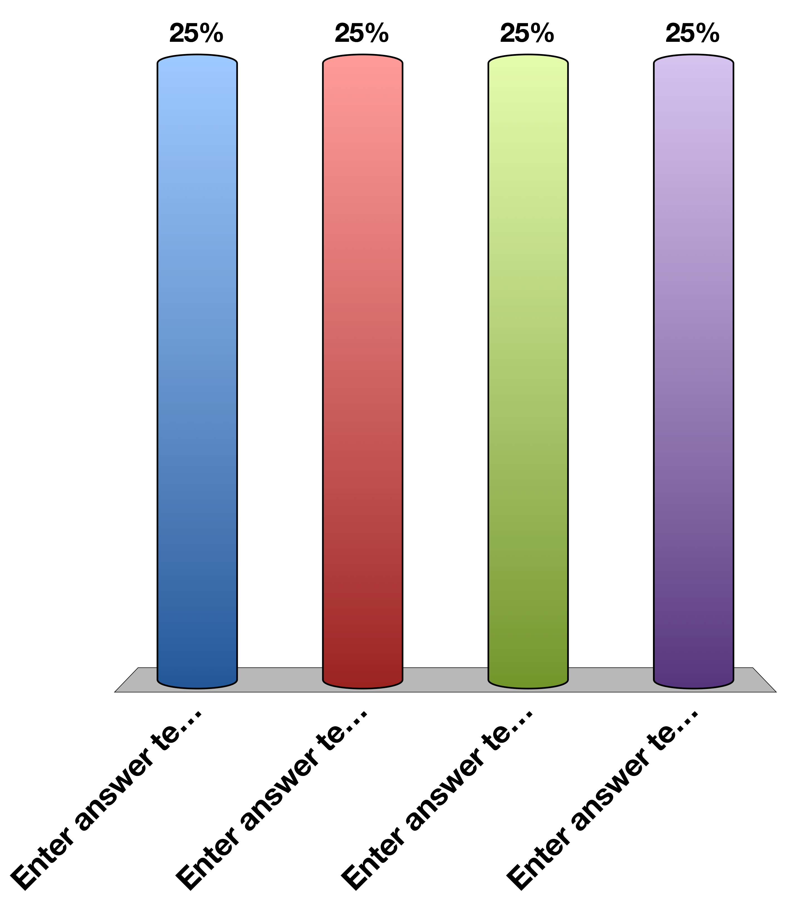
What is sensed by the JG Cells?
Decreased ECF Volume
Increased sympathetic activity
Decreased arterial blood flow
All of the above

Slide 5
JG Cells Release What Factor?
Renin
Angiotensin I
Aldosterone
All of the above

Slide 6
What is the end effect of activating the Renin/Angiotensin System
Angiotensin I formation
Water retention
Vasoconstriction
All of the above

Slide 7
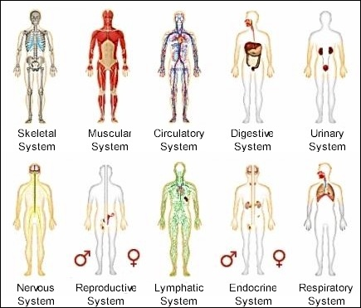
Organ Systems
Notes:
Most organ systems you are learning about in this series are physically connected organelles. These organelles evolved to have extremely important specialized functions, but in physiology these systems must be able to communicate with each other and the outside world

Slide 8
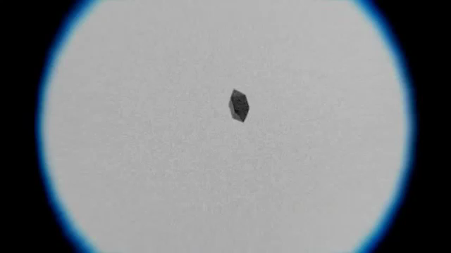
Extracellular Sensing
https://www.youtube.com/watch?v=F6QMU3KD7zw
Notes:
Bacteria chemotaxis around a sugar cube

Slide 9
What are the important processes?
There has to be a signal
That signal has to be detected
The cell has to respond to that signal
After a while the signal has to be stopped

Slide 10
When fight or flight increases blood flow to muscles, what is the signal
Adrenaline
Insulin
Renin
All of the above

Slide 11
What cells respond to that signal
Cardiac muscle
Skeletal muscle
Vascular smooth muscle
All of the above

Slide 12
Every Hormone is Simple
Where is it made?
What causes its release?
What are its receptors?
What tissues does it effect?
How does it get turned off

Slide 13
Example Adrenaline
Where is it made? | Adrenal medulla
What causes its release? | Sympathetic nervous stimulation
What is its receptor? | Alpha/Beta-Adrenergic Receptors (5 subtypes) | GPCR -> Gs and Gi
What tissues does it affect? | Heart | Increased heart rate
 | Lungs | Increased respiration
 | Vasculature | Vasoconstriction (smooth muscle), vasodilation (skeletal muscle)
 | Liver | Glycogenolysis
 | Fat | Lipolysis
 | Skeletal Muscle | Contraction
How does it get turned off? | Sympathetic signal stops

Slide 14
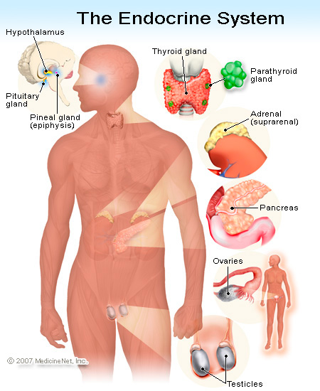
Generally, where are hormones made
Notes:
Total oversimplification as hormones are now known to be made in many other tissues (gut/fat/muscle)

Slide 15
Generally how are hormones released?
Nervous stimulation
Adrenaline, CRH, TSH
In Response to Another Hormone
Cortisol (ACTH), Thyroid Hormones (TSH)
In Response to A Metabolite
Insulin, Glucagon, Calcitonin
In Response to Physical Changes Such As Stretch
Ghrelin, Renin
Notes:
Calcitonin responds to elevated calcium

Slide 16
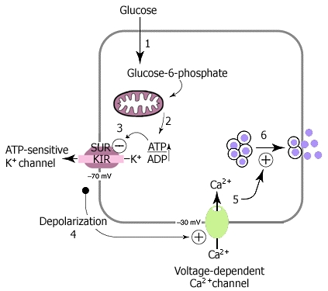
Insulin Release In Response To Glucose

Slide 17
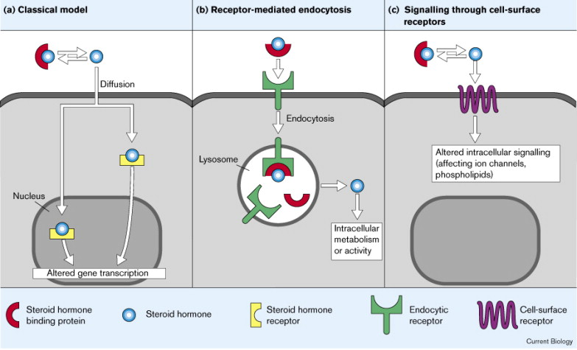
Broadly What Kinds of Receptors Are There?

Slide 18
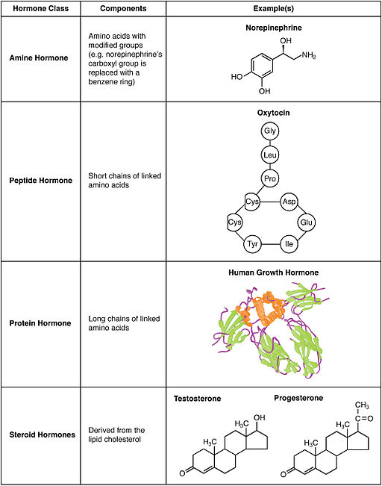
What Kinds of Hormones Are There?

Slide 19
Which hormone type is most likely to be able to cross plasma membranes
An amine such as adrenaline
A peptide such as insulin
A polypeptide such as FSH
A steroid such as testosterone

Slide 20
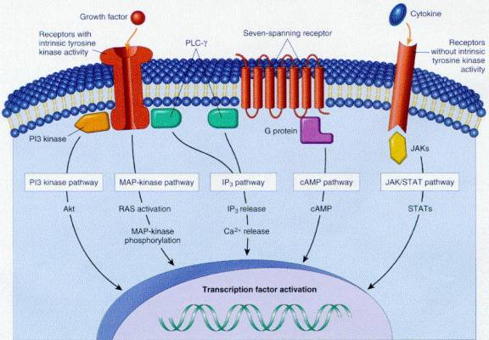
Cell Surface Receptors

Slide 21
Nuclear Hormone Receptors

Slide 22
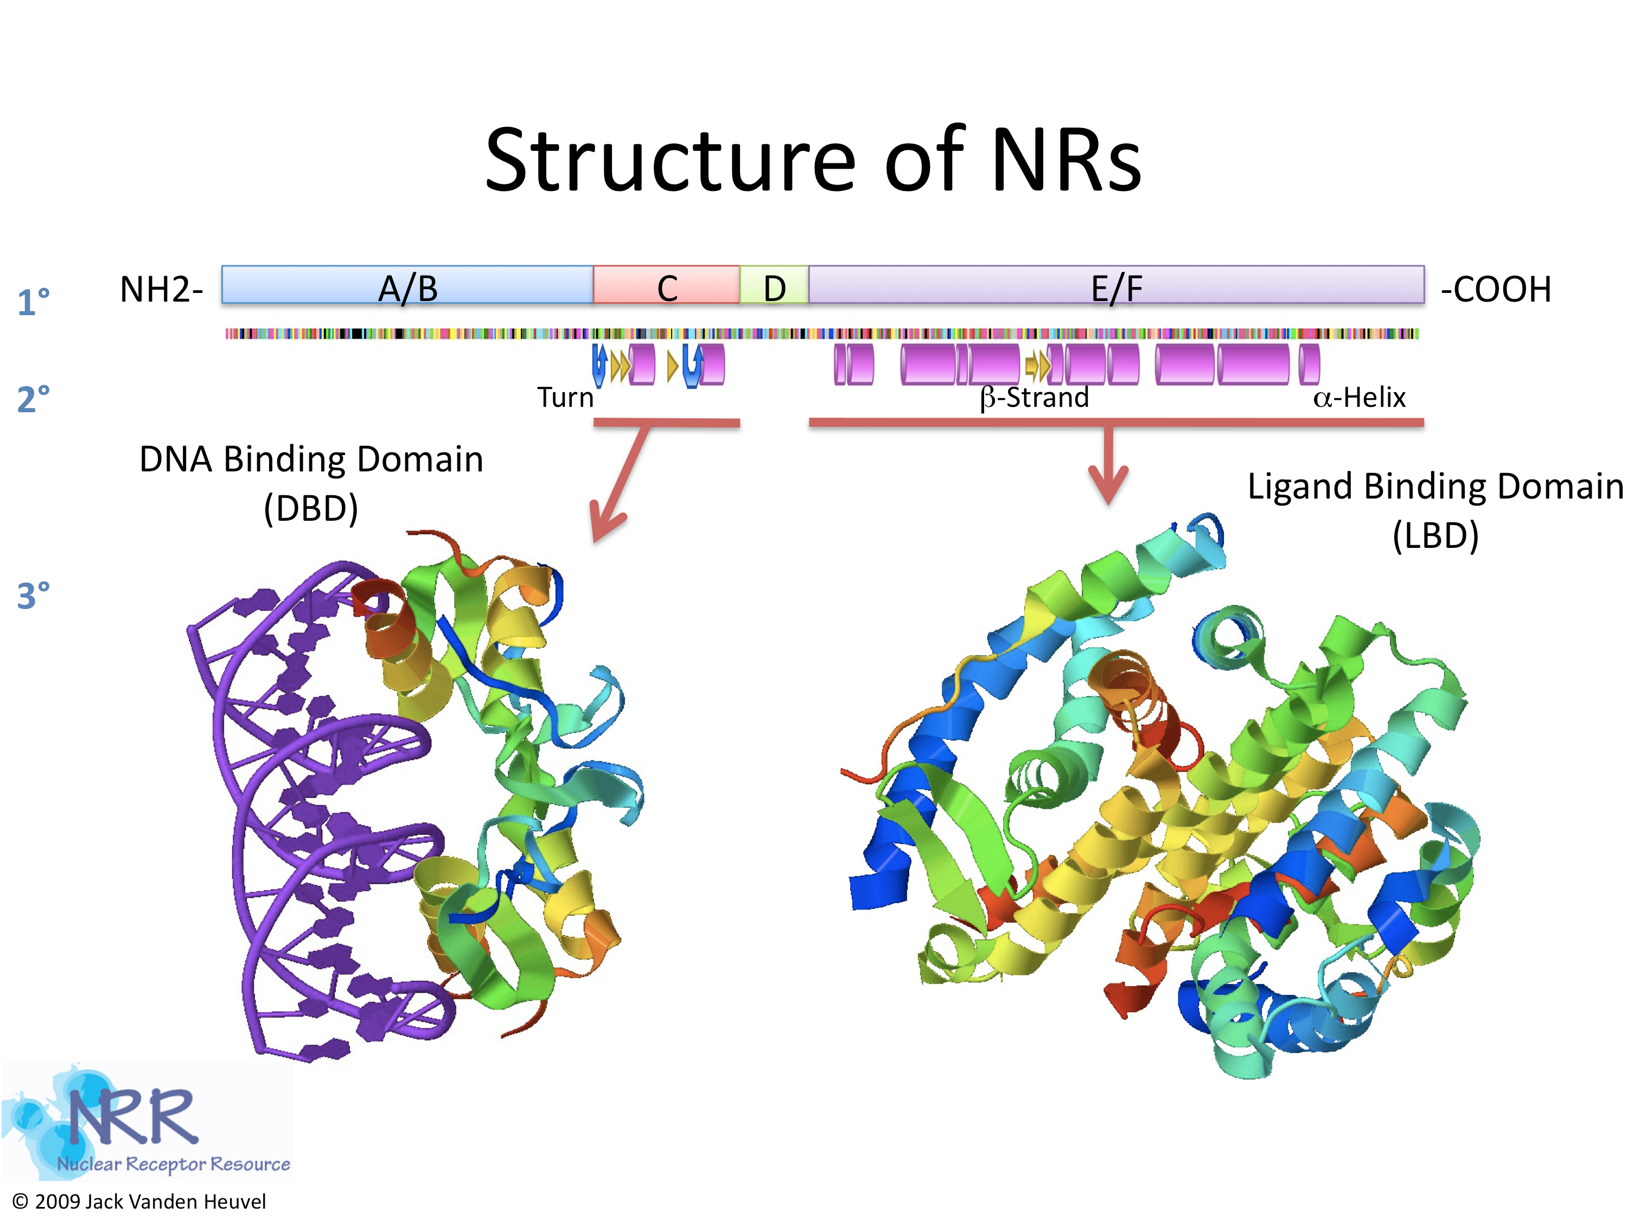
What Do Nuclear Hormones Look Like?

Slide 23
Group Activity
What are some differences in nuclear hormone receptors vs cell surface receptors
What has to be different about the ligands
What has to be different about the responses

Slide 24
General Concepts About Hormone Targets
How does the hormone get from A -> B
Is it released into the blood?
Does it require accessory proteins to help keep it soluble?

Slide 25
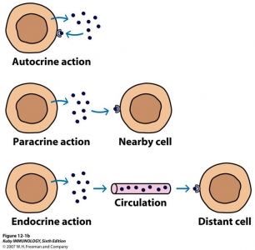
Relative Location of Action

Slide 26
Insulin is released from pancreatic beta cells and is sensed by pancreatic alpha cells to reduce glucagon secretion. This is an example of …
Autocrine action
Paracrine action
Endocrine action

Slide 27
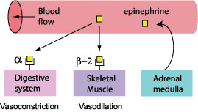
How To Get Hormonal Specificity?
Restrict the location of the hormone release (ie neurotransmitters only released into synapse)
Restrict the receptors to particular tissues
Have the receptors mediate different processes in different cell types
For more details see O’Connell’s lectures on blood pressure regulation

Slide 28
Turning the Signal off
Induce hormone resistance at the target cell
Prevent further hormone production and/or reduce the levels

Slide 29
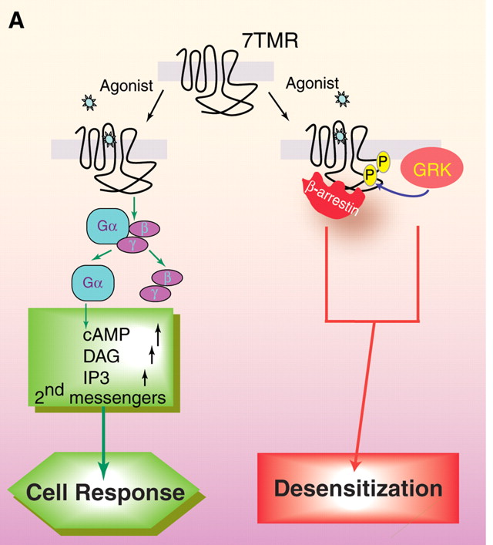
Example: Arrestins and GPCRs
Lefkowitz RJ, Shenoy SK (2005) Transduction of receptor signals by beta-arrestins. Science 308: 512–517. doi:10.1126/science.1109237.

Slide 30
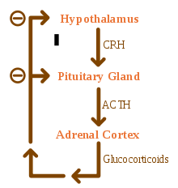
Example: Reduce New Hormone Secretion

Slide 31
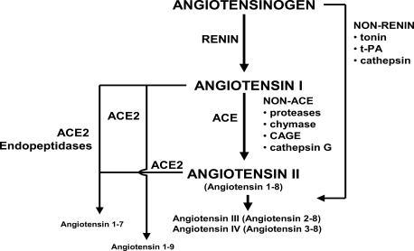
Example: Degrade Existing Hormones

Slide 32
Group Project
Pick some hormone that you think you know of its function
Imagine a patient that has no negative feedback to that hormone. What happens and why?
Now imagine another patient that has way too much negative feedback to that hormone. What happens and why?

Slide 33
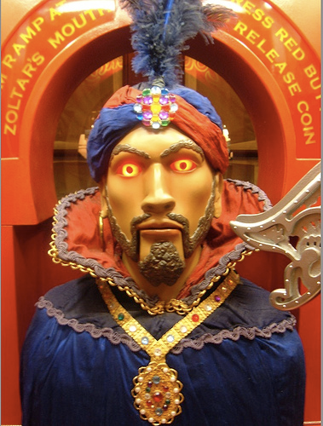
Your Future
Neuroendocrinology and the Pituitary
Hypothalamus and Endocrine Control of Appetite
Endocrine Control of Growth
Adrenals and Stress Hormones
Pancreatic Hormones and Metabolic Control
Thyroid Hormones (KP)
Calcium Homeostasis (MF)
Reproductive Hormones (HP)

